Slide 1
Robot Navigation
A Quick Introduction
Slides by: Alexander Moriarty Presented by: Course: Introduction to Scientific Work Date: 18-12-2013 BRS University of Applied Sciences

Slide 2
Robot Navigation: What?
What is Navigation?
What is Robot Navigation?
Why is Robot Navigation important?
Notes:
1:
Navigation is moving from one location to the other.
In the general case, Navigation is moving from one state to another state. This means not just one location to another, but can include one arm configuration to another.
2:
We will consider robot navigation to be the position component of navigation, and navigation of a manipulator to be Arm Navigation. But of course, Mobile Manipulation requires both components to work together.
3:
Because in order for a robot to do something it needs to get there. Until now, robots have worked in controlled environments in factories behind safety cages.
Robots are becoming main stream, you can pick them up in shops. But these are very “specialized” which don’t preform general tasks, and operate under strict assumptions.

Slide 3
Robot Navigation: Robustness.
What is Robustness?
Where does the navigation work well?
How does the system perform in edge cases?
How do we measure and benchmark ‘Robust Navigation?’
Notes:
1:
Robustness is the ability to overcome the unforeseen, not just to expect the unexpected but to handle the unexpected well.
2:
Most Navigation solutions have been tuned to some environment, when comparing navigation solutions we need to know where it was expected to be used.
3:
What we’re interested in, is how navigation systems perform in different situations for which they were not explicitly designed.
4:
It is hard to determine a situation that the navigation system hasn’t been designed and then test it’s performance in such a situation. Because this could lead to the temptation to over-tune the system.
Robust systems should not be tuned to handle every situation, ideally they should be simple and tuned to handle any situation.

Slide 4
Robot Navigation: Why Robust?
Required for robots to safely operate in unknown, uncontrolled environments.
As researchers in other areas of robotics, why should you care?
With so much talk of robots in the media, hasn’t a solution been found?
Notes:
1:
As humans, we see robotics entering the main stream. - In the last few months, one internet giant has purchased several robotics companies for multi-millions of dollars.
- One online retailer has spent a lot of money for a general system in their warehouses, and have now announced a delivery system for urban areas involving flying robots.
- A well know MP3 producer is quietly spending billions of dollars investing in robotics companies to speed up their production line.
As Robots start to enter our lives, we want to know that they are safe. And that we are not in danger.
2:
It doesn’t matter which area of robotics you’re entering, your components will fail if the robot can not get to where it needs to be to do what you want it to do.
The navigation is the backbone of mobile robotic systems.
3:
Lets go back to one of the above examples:
How much does it cost an internet giant to drive cars autonomously? Business Insider.com reports Google’s self driving Lexus RX450h costs over 300,000$ in hardware. 45,000$ for the car, and another 250,000$ in sensors and computers.
But it can be done cheaper. It has been done for 4,000$ by this years winner of the Intel International Science and Engineering Fair, 19 year old Ionut Budisteanu from Romania.
But it brings us back to safety concerns and robustness. And getting the system approved for use outside of the lab.

Slide 5
Robot Navigation: Challenges
Environments
Dynamic
Time variant
Shared
Costs
Sensor and computational costs keep some solutions out of the question for mass production
Notes:
1:
Dynamic:
Environments are constantly changing, and not always in predictable ways.
On a North American Highway, cars usually driver the speed limit or +10.
Everyone drives the same speed, everyone uses automatic transmissions and most people use cruise control.
The system is in motion, but the dynamics are quite predictable.
No matter how many lanes there are majority of the cars travel the same speed.
Compare this to a three lane German autobahn.
The right lane is full of trucks, travelling between 80-100 km/h.
The middle is full of cars travelling 120-140 km/h
The left lane is for cars who can really move. With the right car you can get well over 200 km/h, twice as fast as the cars two lanes over.
Time variant:
Lets take the nearby HUMA Markt, how does the navigation system preform now that there will be construction for the next few months?
Shared:
How well does the system react with humans or other robots?

Slide 6
Robot Navigation: System
Notes:
This is an overview of a simple navigation system.
The system has requirements. This are specifications given to the system.
The system has components which contain the algorithms.
This is where the important stuff actually happens.
And the system has ways to represent it’s knowledge.
Knowledge and Algorithms should be separated, but they are closely related. Some algorithms can perform better depending on how the knowledge is represented.

Slide 7
Robot Navigation: Requirements
Notes:
The most important requirement a robot navigation system must preform is move from one location to another.

Slide 8
Robot Navigation: Components
Notes:
The components to the navigation system are the implementations of different algorithms
This is were some very important stuff happens. Like Localization.
There are different approaches here, but in this intro we don’t have time to get into details.

Slide 9
Robot Navigation: Implementation
Notes:
Implementation
This is were the different algorithms interact with the knowledge to preform the navigation task, and reach the goals
Some algorithms perform differently depending on the Navigation systems knowledge.
Localization and path planning involve different algorithms so we won’t get into details in this introduction.

Slide 10
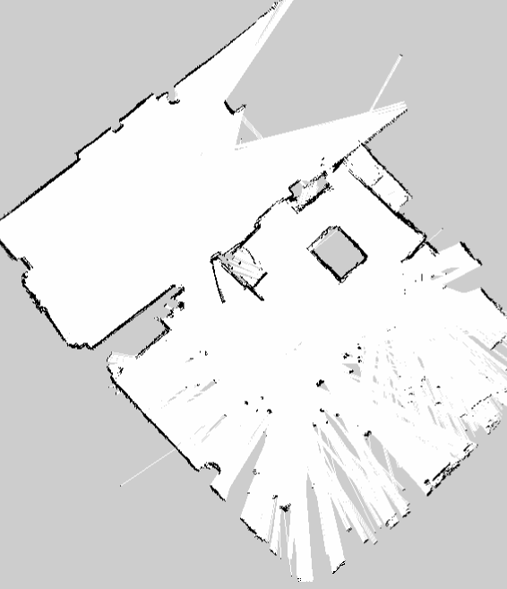
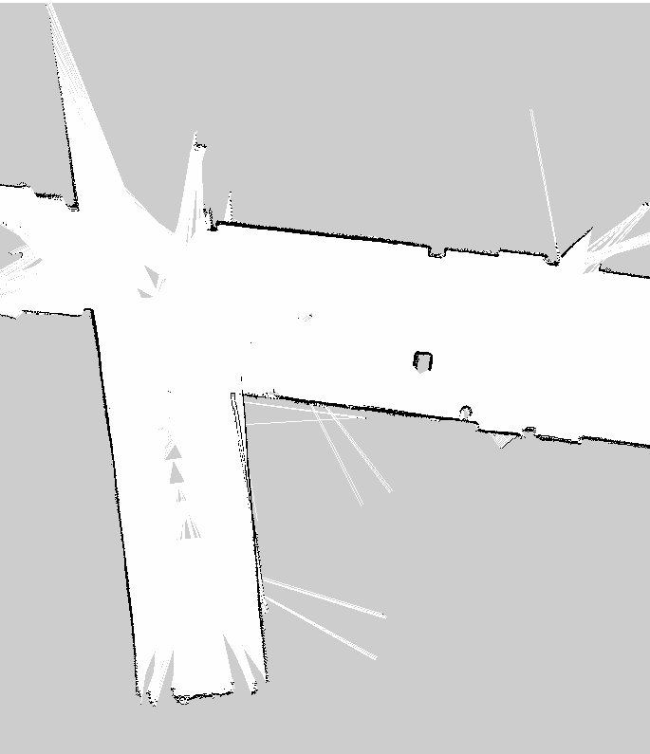
Robot Navigation: An example
Notes:
Robust navigation must preform well in different environments. Here are two nearby environments. In which do you think the robot got lost? The image on the right is the hallway, where 4 similar corridors meet. While mapping a delivery crew brought in two pallets of beer to the Asta storage room.
The hallways are all so similar, and the laser range only long enough to see some of the sides of the corridor it was lost.
In the C025 lab, there are enough unique shapes for the localization to work well.

Slide 11
Future Work
I am actively looking into implementations, but hope that this short introduction gave you an idea of what is robot navigation, and what it is the field is trying to achieve.
The outcome of my ISW report will be to explore further the frontier of navigation implementation in search for robust general solutions.
THANKS

